Slide 1
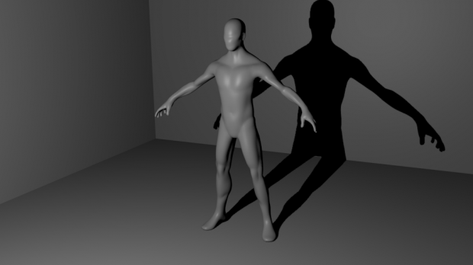
Building a Modular 3D Human
Model using Game Engine​

Slide 2

Work-let Name: Building Modular 3D Human Model using Game Engine
Worklet Details
Worklet ID: RSG26IIITK
College Name: IIITDM, Kurnool
KPIs achieved till now
I . Imported a 3D models and explored by adding lights to the surface and by rotating in various directions and different views.
II . Observed the variations in skin colour and clothes they wear
.
Any Challenges/ Issues faced
While adding a some resources like camera in python file it is showing errors due to not presence of particular .
We resolved this problem by using python console we can add the objects required to form a dataset with images.
Next Steps
Completed a project as per the requirements and created a dataset.
All files are uploaded into github and one of the google drive where we uploaded in the milestone
Key Achievements/ Outcome till now
Created dataset consisting of images which are rendered from the blender using python scripts.
Date: 04-08-2023

Slide 3
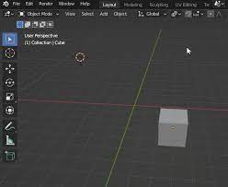
Intially we write the code to add the objects into software.
Refer the ( Readme.txt ) file to know the complete working of the code snippet
By using primitive_add() built in function we can add the objects
Intially the objects will be at origin after giving certain position to relocate the object will be relocated to that location and size function will helps in change of the size of the object .
Assing the location will follow this syntax:
Object.location[0] = relocated value
Size = x

Slide 4
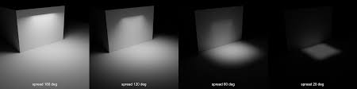
The light source is of type POINT, which is similar to artificial light. To control the power of the light source, we set the intensity in watts.
To create a new material intially we have to allow the " use_nodes = True " api to use nodes functionality.
While creating different material shaders there will be different shader nodes like glass metallic and jelly.
Now we can generate the image and have to save that image in PNG format and which looks more realistic due to using of different materials.

Slide 5
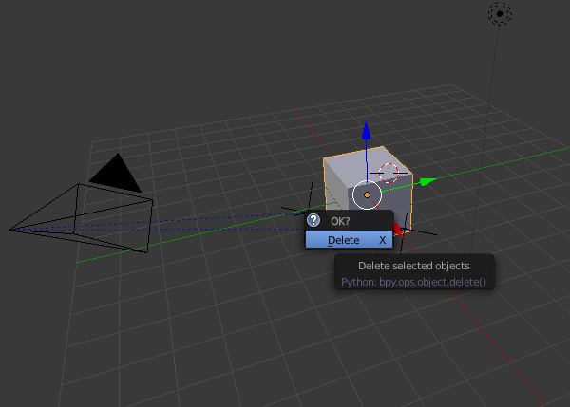
No by using the euler function we can rotate the camera around the object by using the "TRACK_TO" built-in function to follow a single object to track.
From this we can observe how to rotate a virtual camera around an image and use it to render from 3D to 2D from different viewpoints using the Blender API.​

Slide 6
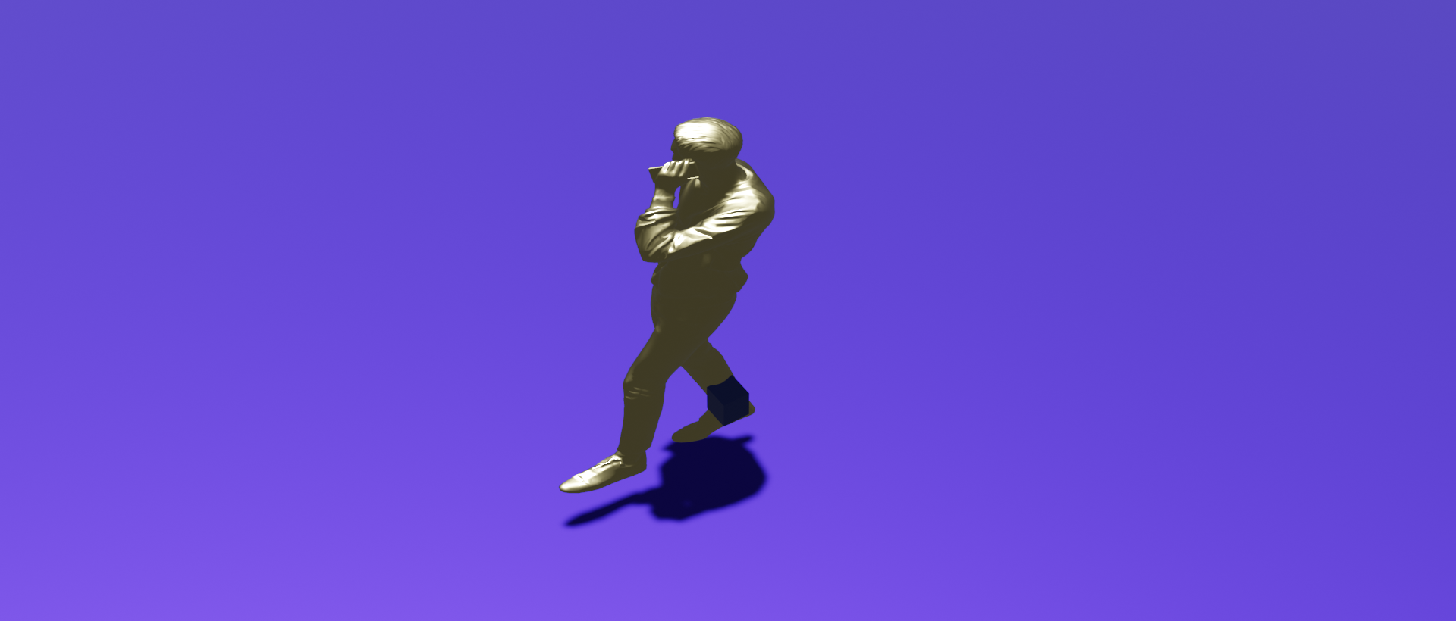
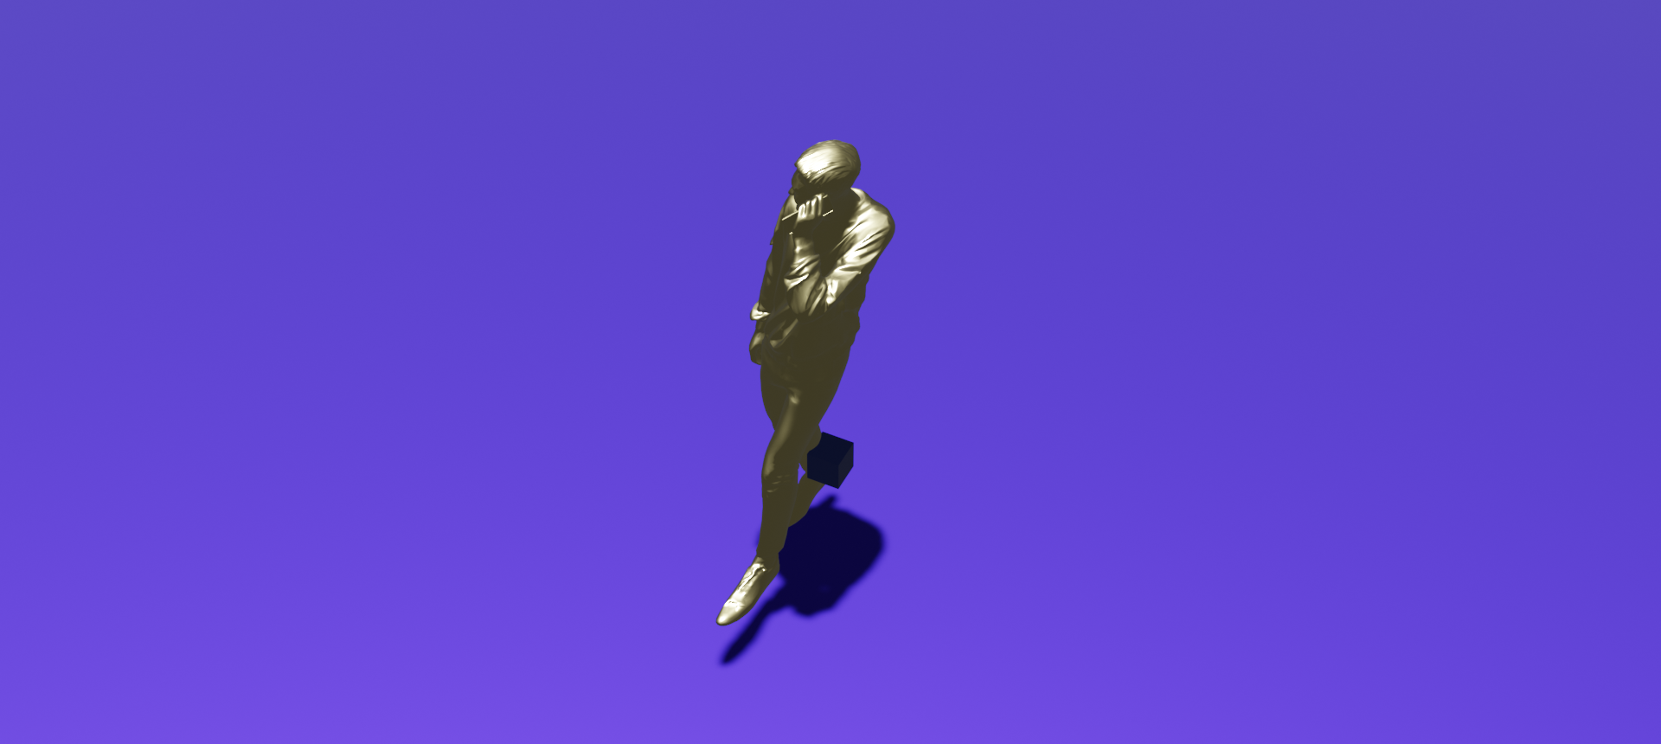
30°
0°

Slide 7
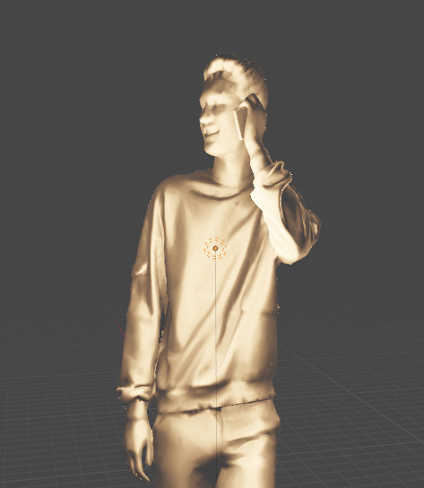
From starting of this project we started working on the blender to generate a modular 3D human model for observing different variations :
•Appearance (Identities – racial, face shape, eyes)
•Hair style and color
•Eyebrows and Facial Hair styles
•Skin tone changes
•Clothes and (props such as caps and glasses)

Slide 8
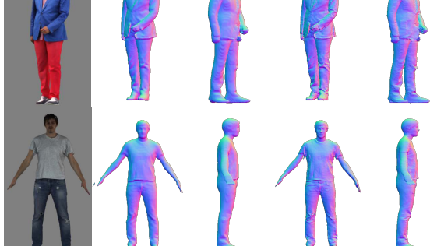

Slide 9
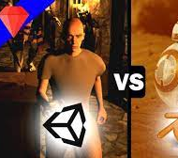

Drawbacks from blender and unity
Blender is well known for its easy workflow. The software is very customizable with hotkeys and layout changes. Blender also integrates with many other programs for easy importing and exporting of files.
One drawback of both programs is the computing power that is needed to keep each program running. It can be a big stress on a computer to run Blender or Unity, especially while rendering.
Blender uses Cycles, a ray-trace-based render engine. It can utilize multiple CPU and GPU cores for geometry, subdivision, displacement, shading, lighting, motion blur, and many more aspects of 3D rendering.
Unity uses the Universal Rendering Pipeline for rendering, a scalable multiplatform pipeline.
Unity has a wide range of 3D features that make it great for 3D design. The software can be used for 3D modeling, animation, rendering

Slide 10
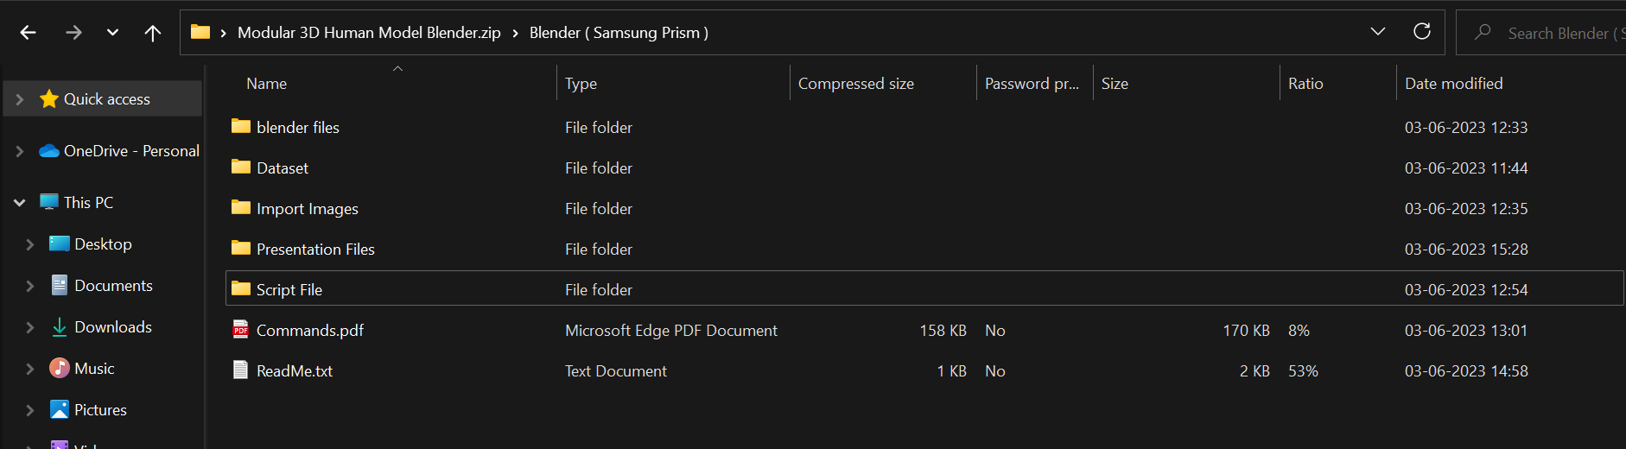
Zip Folder to be upload into github

Slide 11

Work-let Closure Details
Code Upload details:
Items | Details
KLOC (Number OF Lines of codes in 000’s) | 0.12
Model and Algorithm details | Blender python module and Rotation Matrix
Is Mid review, end review report uploaded on Git ? | Yes
Link for Git | https://github.ecodesamsung.com/SRIB-PRISM/3D-Model-Using-Blender
Data details (if applicable):
Items | Data folder 1 | Data folder 2 | Data Folder 3……..
Name & Type of Data (Audio/Image/Video) | Dataset | Final Script | Presentation Files
Number of data points | 3 | 1 | 1
Source of Data (self collected, Scrapped, available on open source) | self collected | Open Source | Self Collected
Google drive link/ git link to access data | https://github.ecodesamsung.com/SRIB-PRISM/3D-Model-Using-Blender/tree/main/Dataset | https://github.ecodesamsung.com/SRIB-PRISM/3D-Model-Using-Blender/tree/main/Final%20Script | https://github.ecodesamsung.com/SRIB-PRISM/3D-Model-Using-Blender/tree/main/Presentation%20Files

Slide 12
Thank You
R & D Mentors:
Abhishek Kumar Mishra
Pidaparthy Hemanth
Students:​
​
P Jagadeesh ( 120Cs0032 )​
G Nagendra Babu ( 120Cs0031 )​
M Deepika ( 121AD0038 )
Professors: ​
​
Prof: D.V.L.N Somayajulu​
Dr. J. Krishnaiah​
​

